Slide 1
Visualizing and Forecasting COVID-19 Data with Power BI and Excel

Slide 2
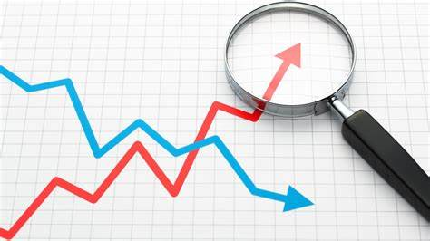
Introduction
Welcome to the transformative world of "Visualizing and Forecasting COVID-19 Data with Power BI and Excel." In the wake of the unprecedented global challenges posed by the COVID-19 pandemic, this project focuses on unraveling insights globally as well as specific to India.
Leveraging the robust capabilities of Microsoft Excel, Power BI, and Python libraries including Matplotlib, Seaborn, Pandas, and NumPy.
Our mission is to analyze the pandemic's progression, predict future trends, and deliver actionable insights on confirmed cases, recoveries, and deaths.

Slide 3
Project Idea
Our project idea revolves around leveraging Microsoft Excel, Power BI, and Python data analysis libraries, powerful tools for data analytics, to process, analyse, and visualize both global and India-specific COVID-19 data.
This project seeks to create predictive models using advanced features of Power BI and Python libraries for forecasting the future trajectory of COVID-19, enabling healthcare professionals, policymakers, and the public to make well-informed decisions.

Slide 4
Overview of the Minor Project
Data Cleaning
Data Transformation
and Integration
01
02
Data Visualization
Data Forecasting
03
04

Slide 5

Data Collection and Preprocessing
Multiple Datasets
time_series_covid19_confirmed_global
time_series_covid19_deaths_global
time_series_covid19_recovered_global
time_series_covid19_india
Cleaning and Integration
Transformation and Manipulation

Slide 6

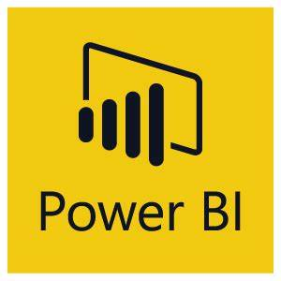

Data Visualization and Forecasting
A visual narrative unfolds in the Data Visualization segment.
Through Matplotlib, Seaborn, and Power BI, we craft compelling visuals that transcend raw numbers. These visuals offer a clear representation of COVID-19 trends, turning complex data into actionable insights.
Applied Power BI's forecasting tools to predict future trends.

Slide 7
Functionality
01 | Data Collection and Cleaning | Utilize Microsoft Excel and Python libraries (e.g., Pandas) for data collection and cleaning. Gather COVID-19 data from reliable sources and preprocess it using Pandas to eliminate inconsistencies and missing values.
02 | Descriptive Analysis | Microsoft Excel and Python data analysis libraries (e.g., Matplotlib and Seaborn) will be employed for in-depth statistical analysis. These libraries help generate graphs and charts to comprehend current pandemic patterns, including infection rates, mortality rates, and testing trends.
03 | Predictive Modeling | Develop forecasting models using advanced Power BI features for predicting future COVID-19 cases, deaths, and recoveries both on a global and Indian scale.
04 | Data Visualization | Utilize Power BI to craft interactive dashboards and visualizations, enhancing effective data communication.
05 | Data Integration | Merge global and India-specific data using Power BI and Python libraries for comprehensive data integration, providing a holistic view of the pandemic's impact.

Slide 8
Future Work
C
O
The future scope of this project encompasses:
Continuous updates of predictive models with the latest data to enhance forecasting accuracy.
Collaboration with healthcare experts, government bodies, and Outreach for real-time decision support
Expanding data sources to include more detailed demographic and geographic information by Utilizing additional resources
Developing a user-friendly web interface or application for public access to data and predictions with a Navigable design
Tapping advanced Artificial Intelligence and Machine learning algorithms in Python libraries to improve the model's ability to learn complex relationships between the features and the target variable.
U
N
T

Slide 9
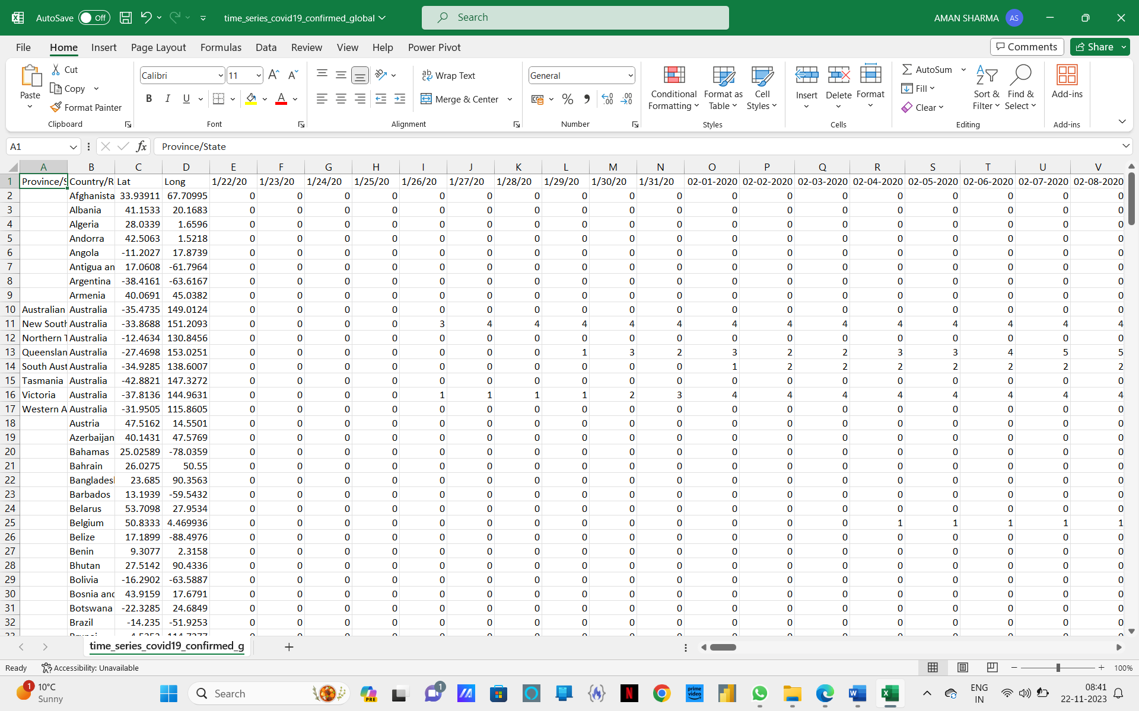
Display Shots
1
Data Collecting
time_series_covid19_confirmed_global

Slide 10
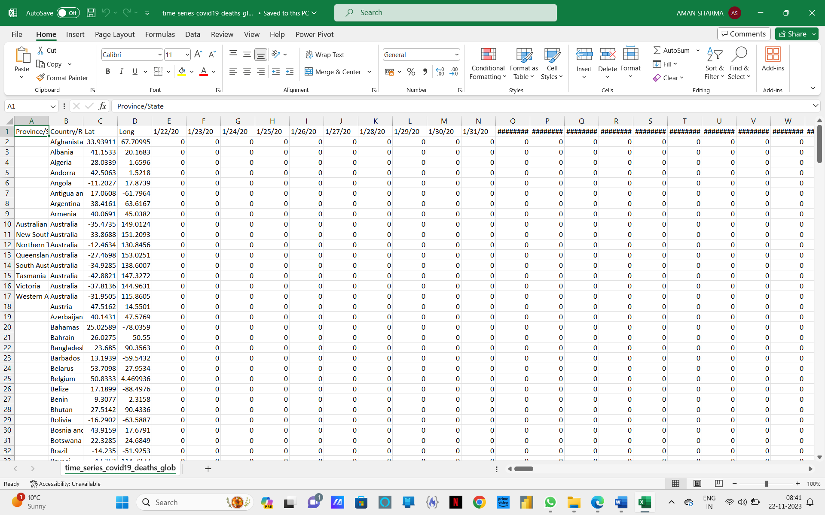
Display Shots
2
2. time_series_covid19_deaths_global

Slide 11
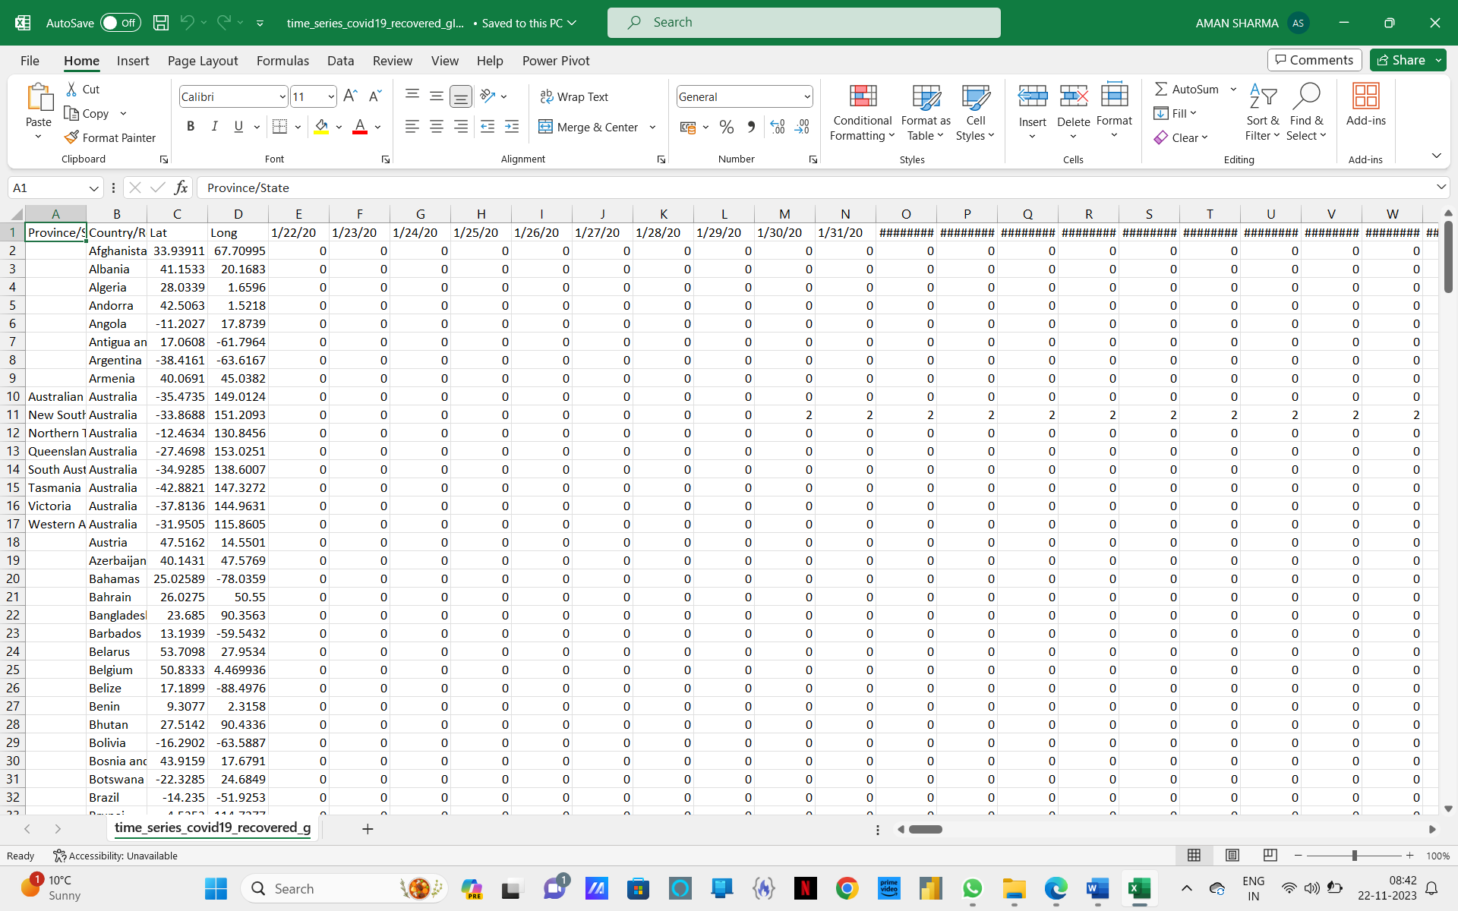
Display Shots
3
3. time_series_covid19_recovered_global

Slide 12
Display Shots
4
3. time_series_covid19_recovered_global

Slide 13
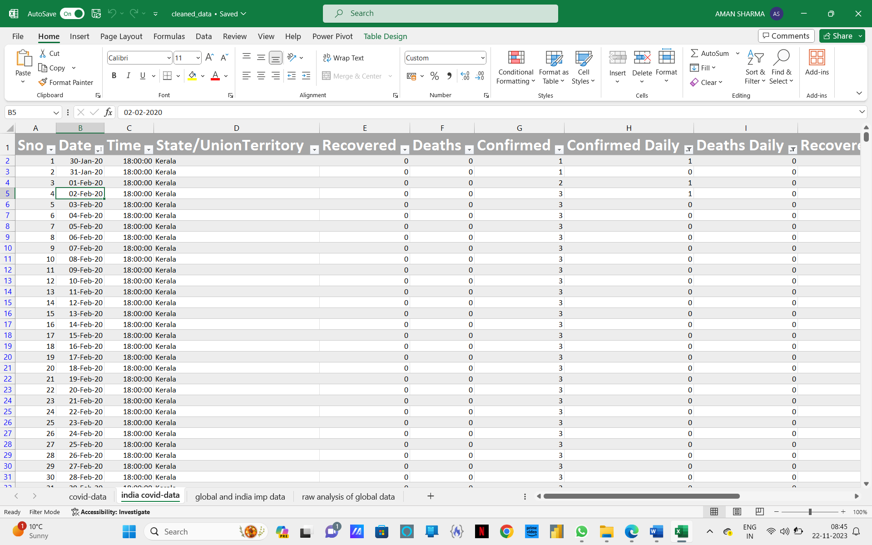
Display Shots
5
4. time_series_covid19_india

Slide 14
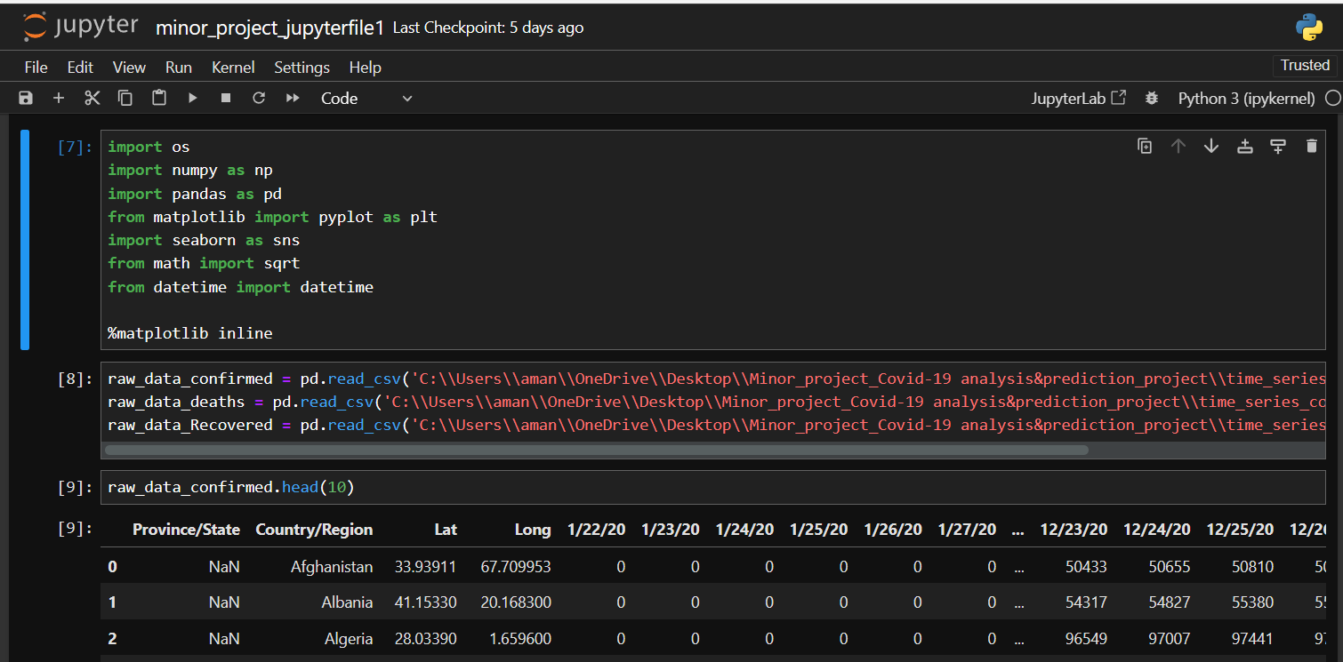
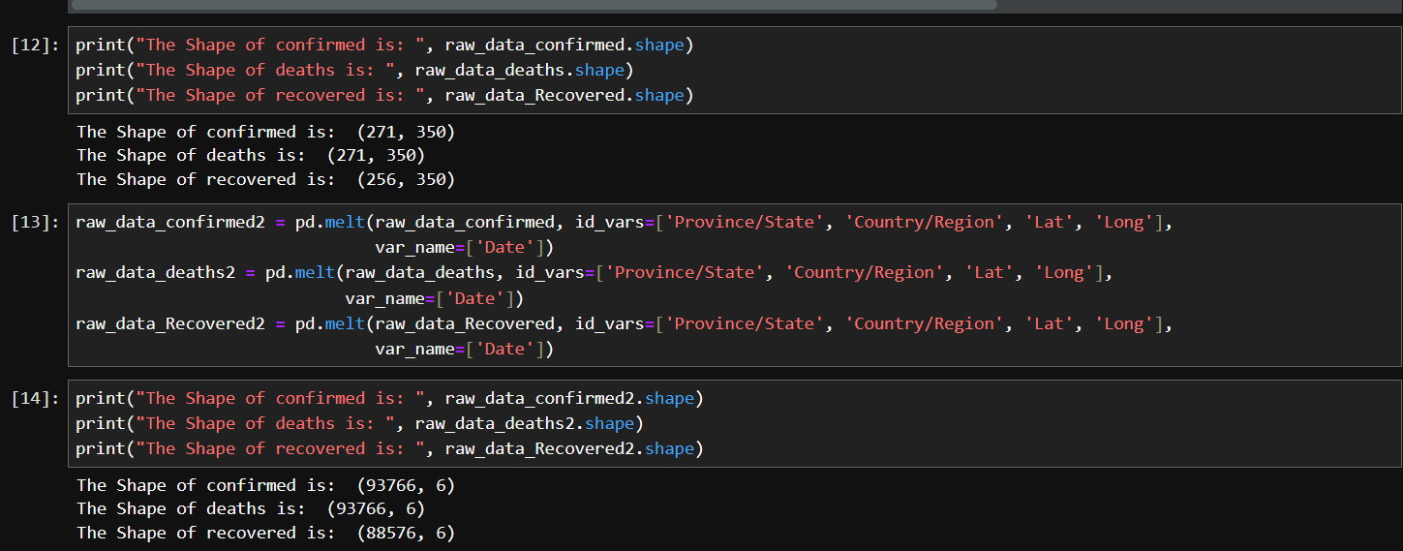
Display Shots
6
Data Cleaning, Data Transformation, Data Integration

Slide 15
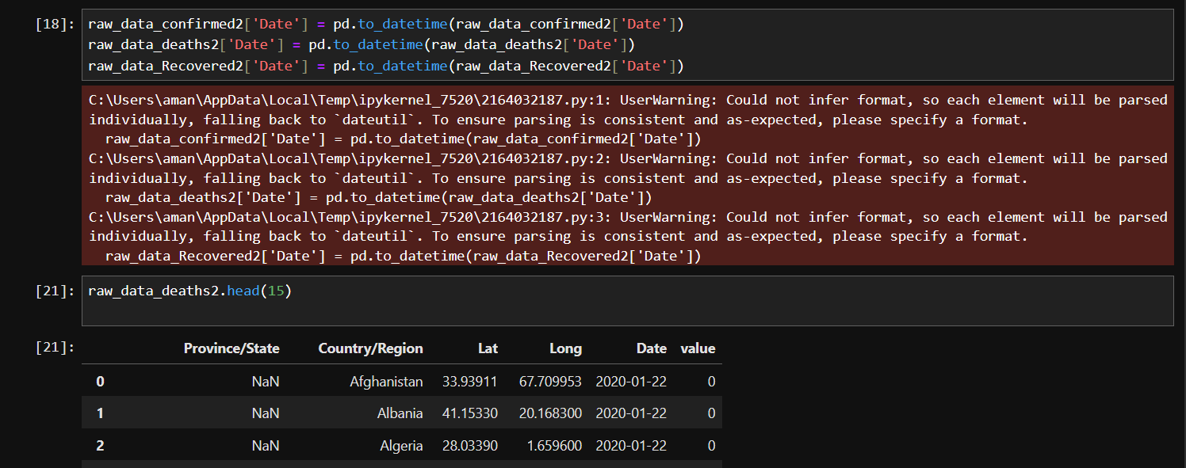
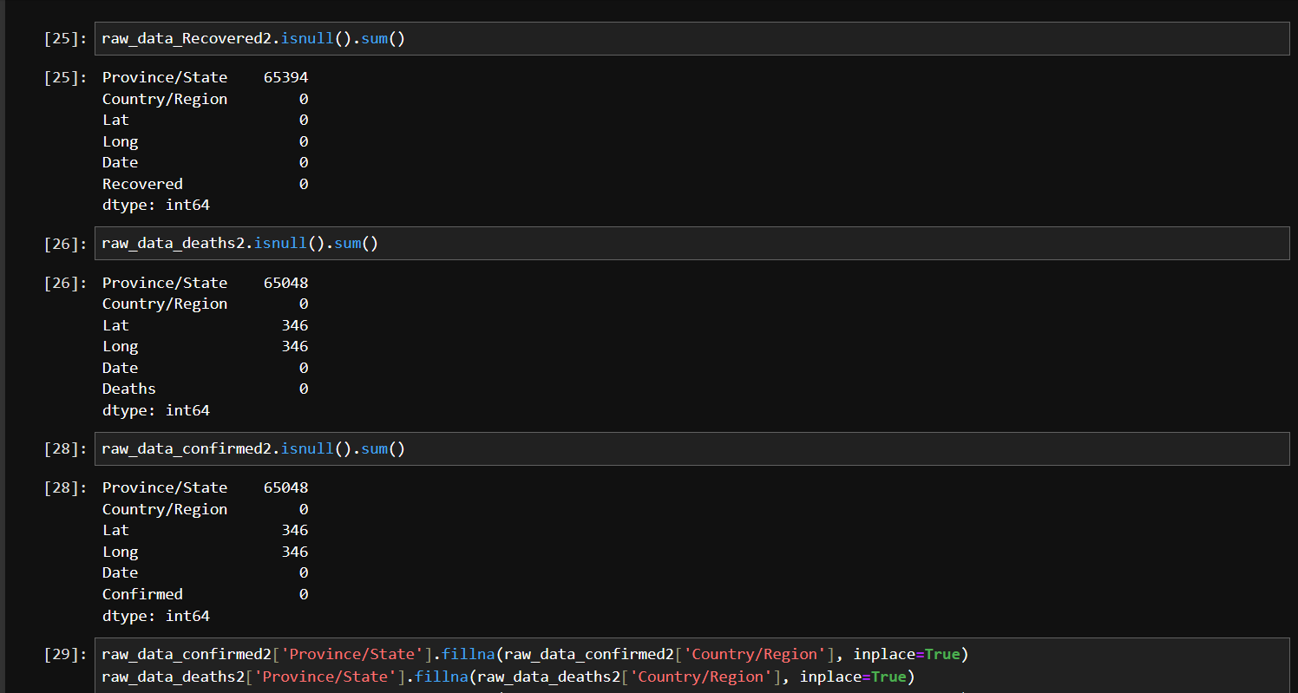
Display Shots
7

Slide 16
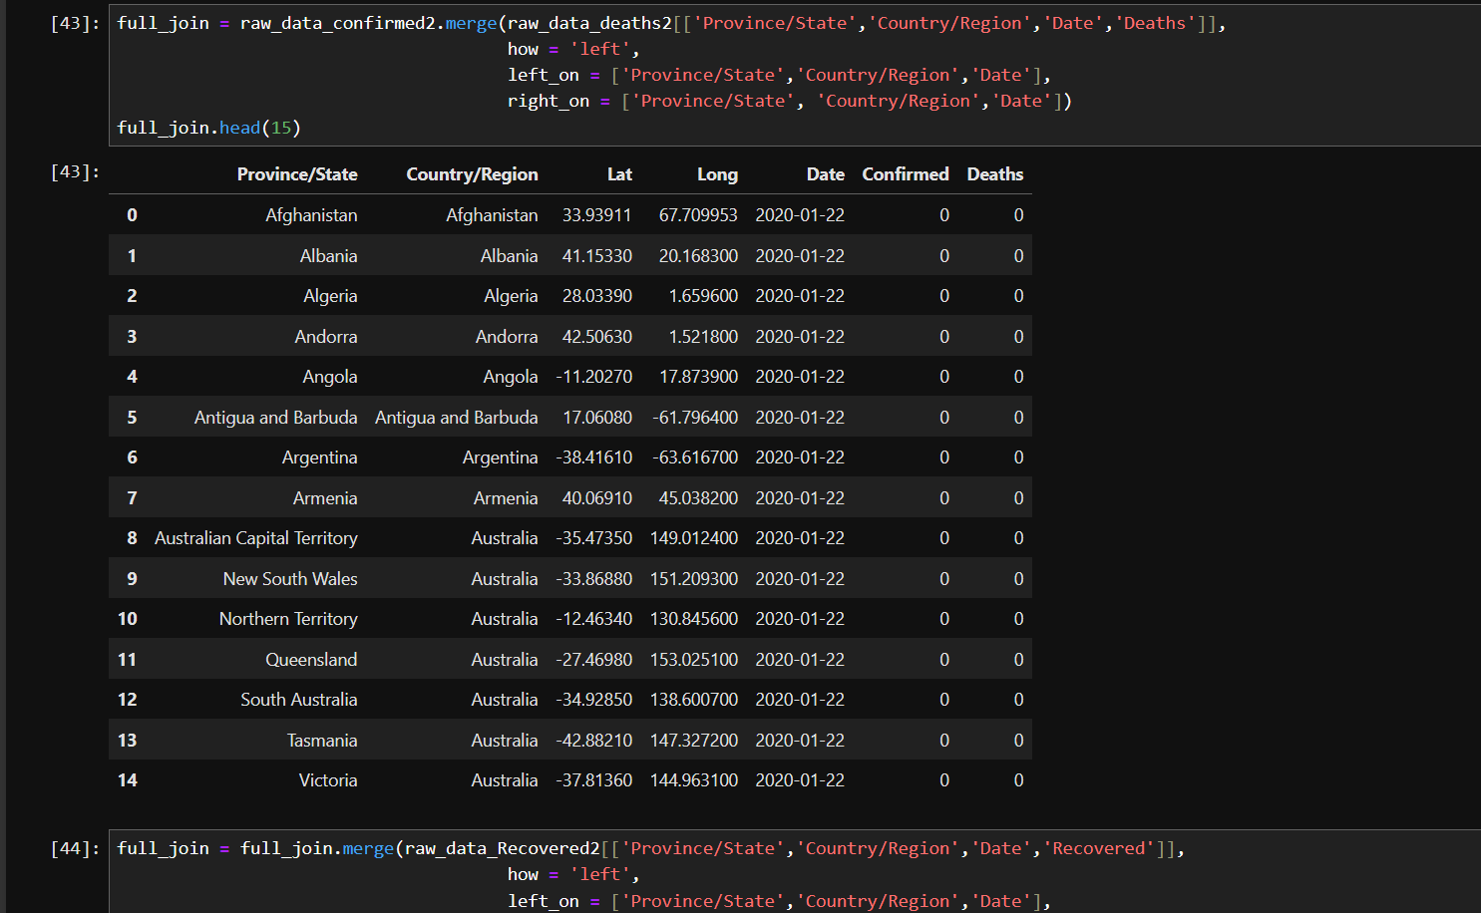
Display Shots
8

Slide 17
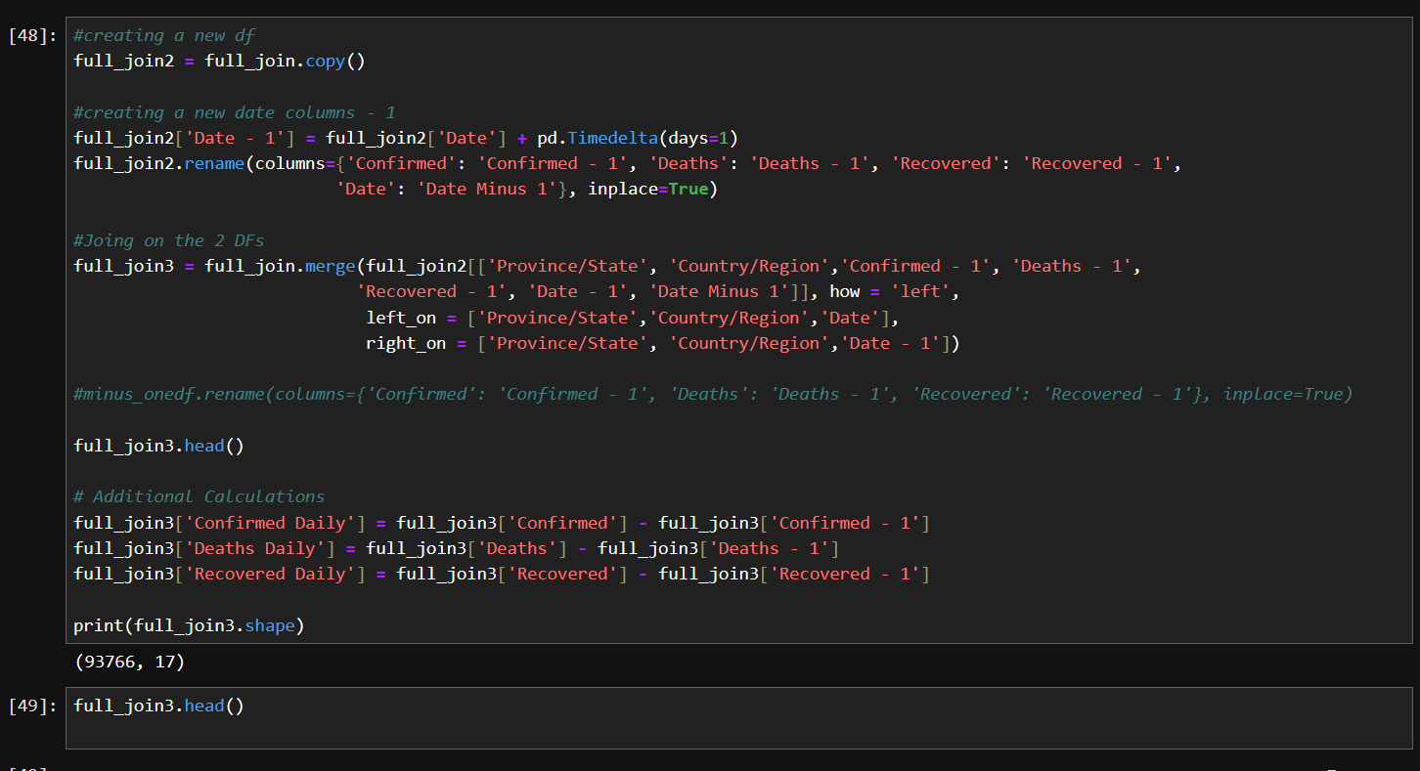
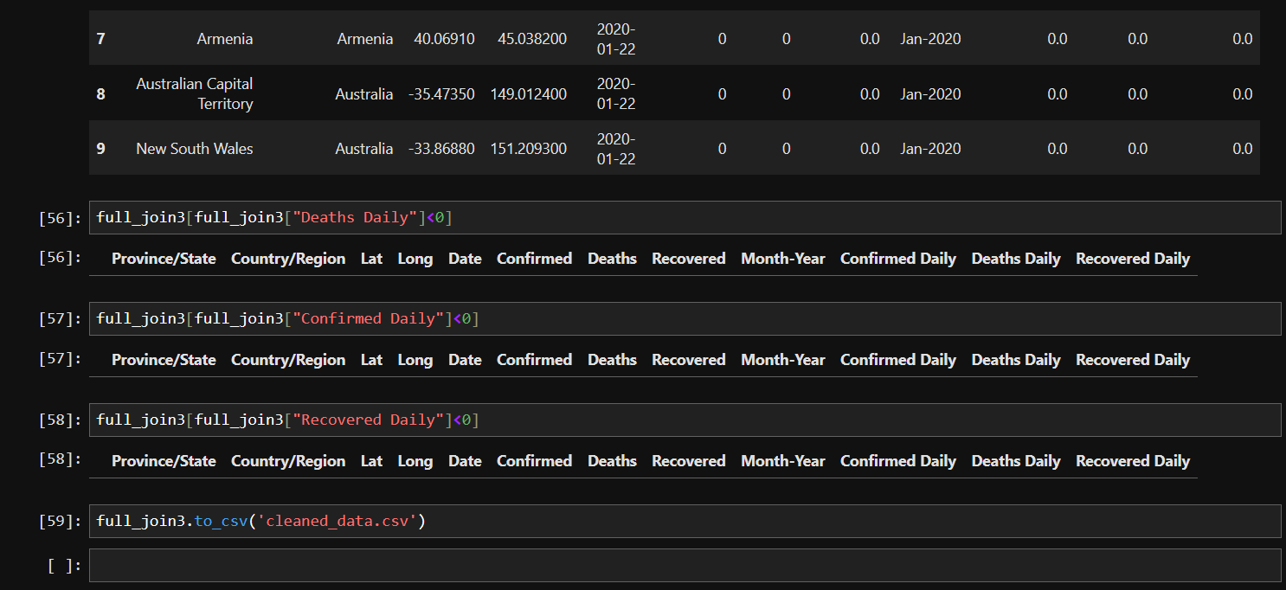
Display Shots
9

Slide 18
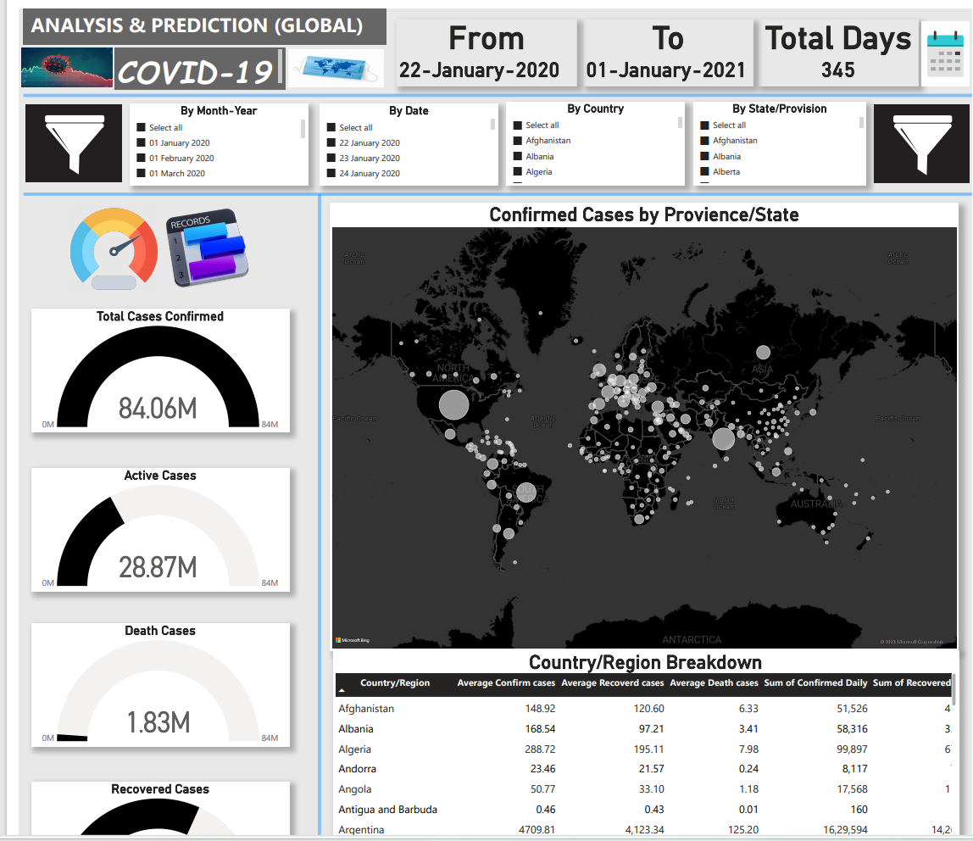
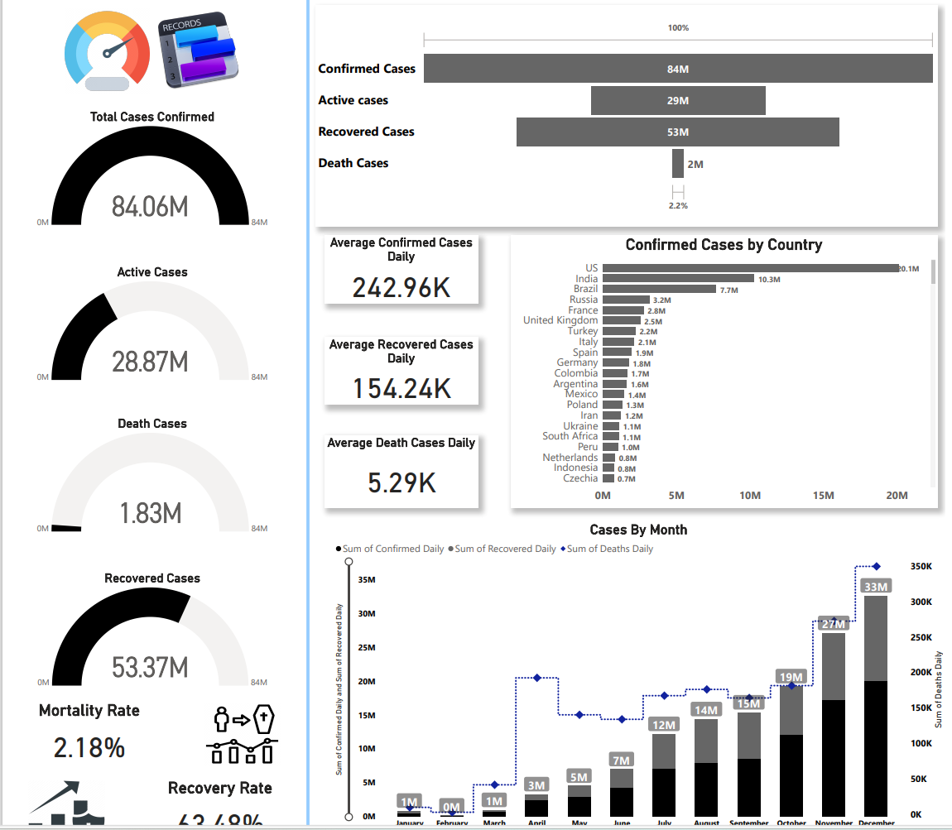
Display Shots
10
Data Visualization and Forecasting

Slide 19
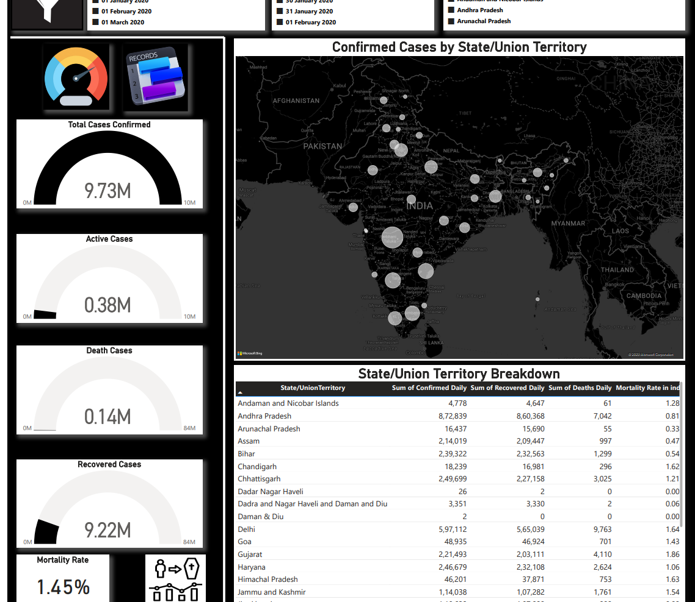
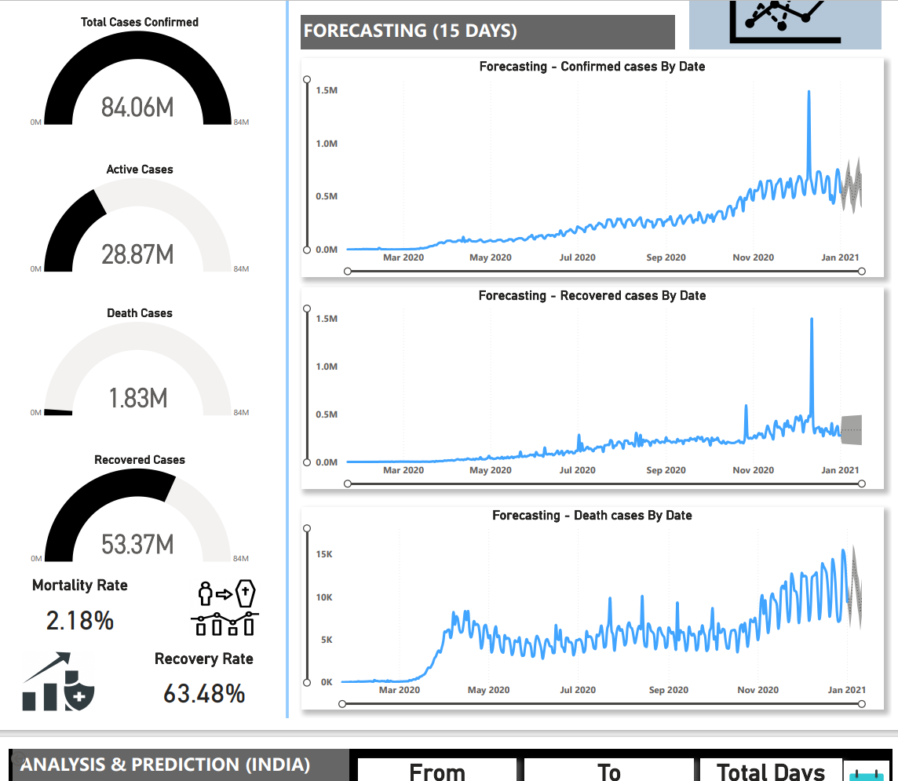
Display Shots
11

Slide 20
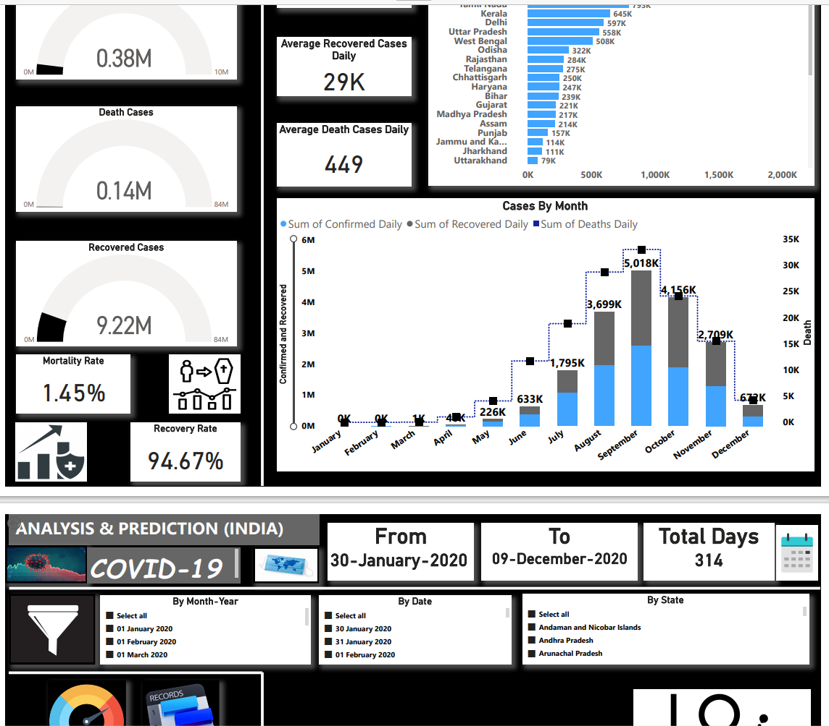
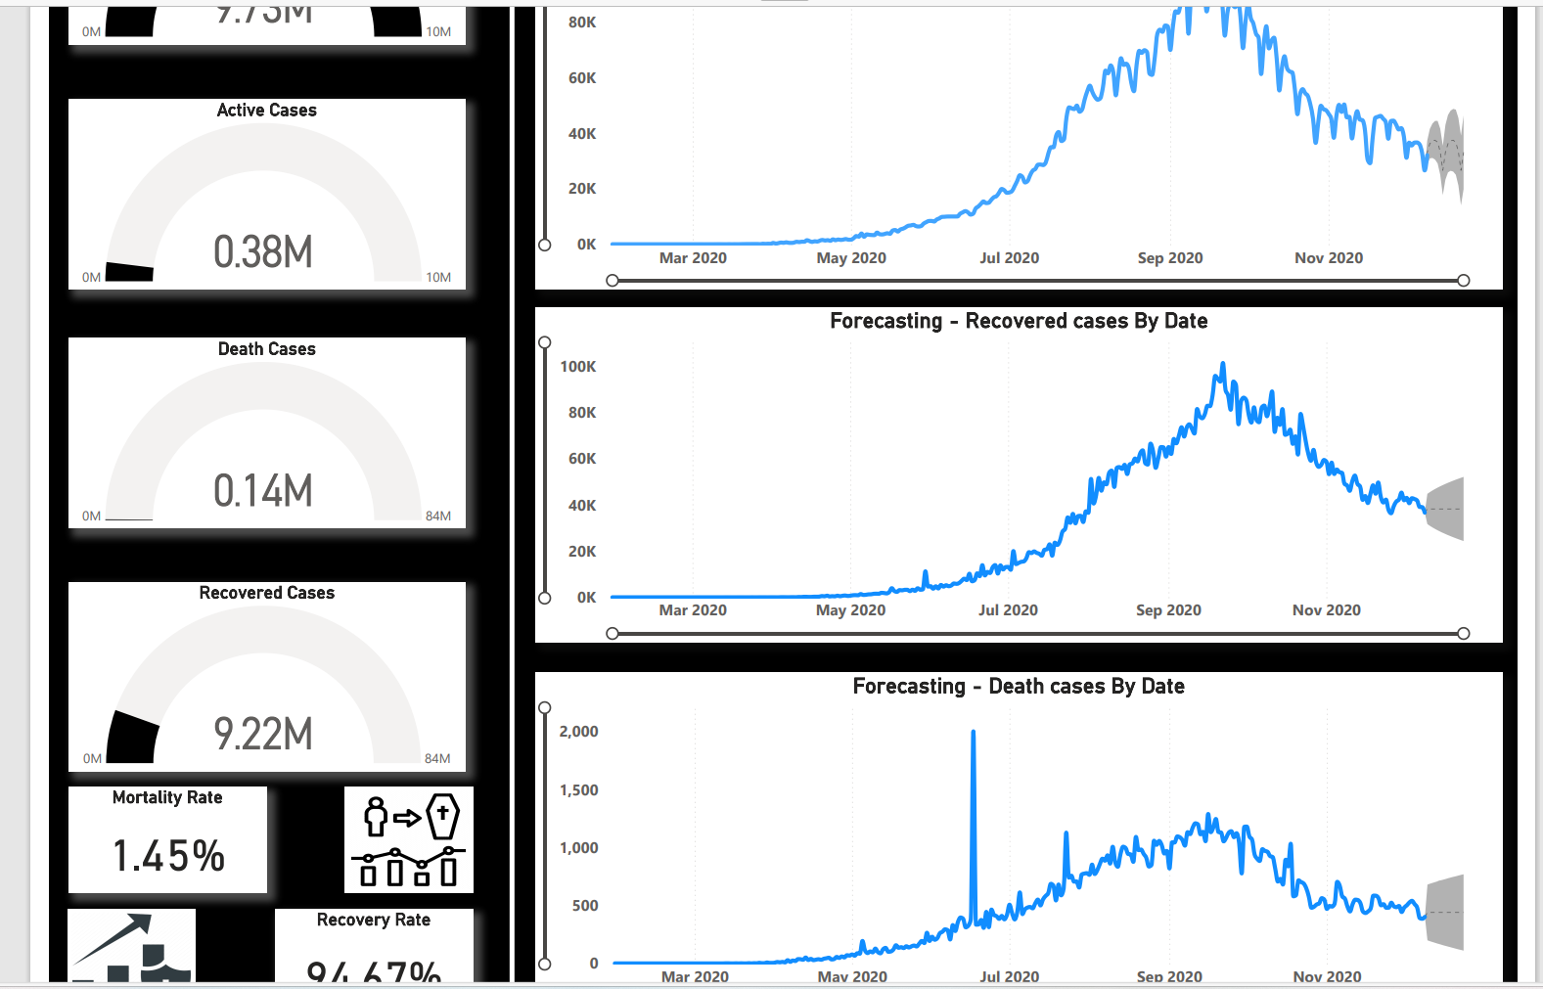
Display Shots
12

